Slide 1
Predicting Steering Angles for a Self Driving Car Section 4
Notes:
In this section we are going to look at some of the computer vision and AI technology used in self driving cars, specifically an approach to predict the steering angle based on a feed of images of the road ahead.

Slide 2
What we will cover in this section
IMPORTANT REMINDER!!
How can we predict steering angles for a car
What are convolutional neural networks (CNNs)
Environment and dataset
Exploring our data
Training our model
Testing our model
Notes:
This slide, like mentioned above is for multiple pointers. The information above covers the types of information that can be used in this slide
https://aws.amazon.com/blogs/machine-learning/build-your-own-face-recognition-service-using-amazon-rekognition/

Slide 3
THIS CODE IS NOT DESIGNED FOR REAL LIFE USAGE!
Notes:
So let’s start with a very important message, this code is not designed to run on a real car. There are a large number of safety features that a real autonomous vehicle has that we won’t cover here. However, section is designed to introduce you to an approach to do this, and can help you get started on a career in this space if you so wish!

Slide 4
4.1 CNNs
Notes:
In this section we are going to look at some of the computer vision and AI technology used in self driving cars, specifically an approach to predict the steering angle based on a feed of images of the road ahead. A widely used technology in this space is called the Convolutional Neural Network

Slide 5
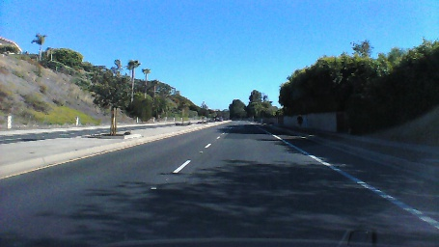
How can we predict the steering angle of a car?
Convolutional
Neural Network
+1.45 degrees
Notes:
Predicting the steering angle can be done in a number of ways. It is possible to detect the lines in the road using computer vision techniques, calculate any angle in them, and use this to determine an appropriate steering angle. Another approach is to use deep learning. We are going to use a convolutional neural network to learn patterns in road images and predict steering angles. Our training data will consist of multiple road images and a corresponding steering angle captured from a car.

Slide 6
What are Convolutional Neural Networks (CNNs)
CNNs are a class of deep, feed-forward artificial neural networks, most commonly applied to analyzing visual imagery.
They are modelled on the visual cortex where individual neurons respond to stimuli only in a restricted region of the visual field known as the receptive field.
CNNs use relatively little pre-processing compared to other image classification algorithms.
Notes:
Convolutional networks were inspired by biological processes[4] in that the connectivity pattern between neurons resembles the organization of the animal visual cortex. Individual cortical neurons respond to stimuli only in a restricted region of the visual field known as the receptive field. The receptive fields of different neurons partially overlap such that they cover the entire visual field.
CNNs use relatively little pre-processing compared to other image classification algorithms. This means that the network learns the filters that in traditional algorithms were hand-engineered. This independence from prior knowledge and human effort in feature design is a major advantage.
Yann Lecun pioneered the use of convolutional neural networks.

Slide 7
What are Convolutional Neural Networks (CNNs)
Notes:
In this image you can see how a CNN has learnt to identify edges and textures, the builds higher level representations, such as the parts of a car, then more complete images of a car before finally recognising that, in this image, it’s an Audi A7. None of these representations are programmed, the network learns these from training examples.

Slide 8
Environment and Data
Notes:
In the next video we’ll look at the environment and data we need to code this

